Slide 1

Data Wrangling with the Tidyverse
Notes:
Welcome to the workshop

Slide 2
HELLO
my name is
Garrett
 @StatGarrett
Notes:
My name is Garrett. I'm a Data Scientist who works for RStudio, the company that makes all of the free software that we're going to use today.

Slide 3
HELLO
my name is
Carl
Notes:
My name is Garrett. I'm a Data Scientist who works for RStudio, the company that makes all of the free software that we're going to use today.

Slide 4

Notes:
I've written several books on the R language including, R for Data Science, which this workshop will be loosely based around.

Slide 5
HELLO
my name is
TA
 @TA

Slide 6
HELLO
my name is
Gwynn
Notes:
Joining me today is Gwynn Sturdevant, who will be acting as a TA for the workshop. If you get stuck at any point in the workshop, simply raise your hand and Gwynn or I will come and assist you.

Slide 7
(Applied) Data Science
Visualize
Import
Tidy
Model
Communicate
Transform
Program

Slide 8
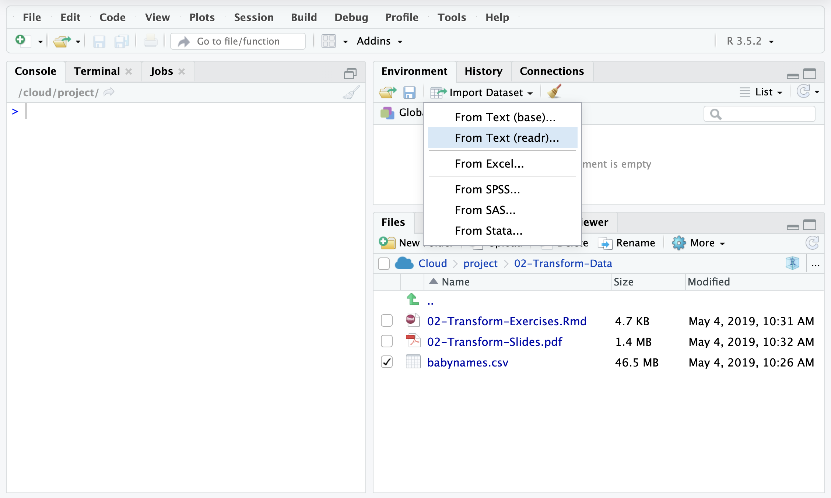

(Applied) Data Science
Visualize
Tidy
Model
Communicate
Transform
Program

Slide 9

(Applied) Data Science
Tidy
Model
Communicate
Transform
Program

Slide 10

(Applied) Data Science
Tidy
Model
Communicate
Program

Slide 11
(Applied) Data Science
Tidy
Communicate
lm()
Program

Slide 12

(Applied) Data Science
Tidy
lm()
Program

Slide 13

(Applied) Data Science
Tidy
lm()
Program

Slide 14
(Applied) Data Science
Tidy
lm()
Program

Slide 15
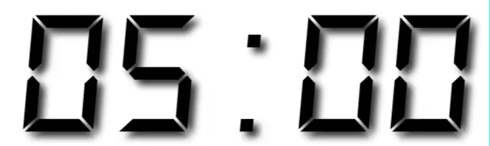
Your Turn
Form groups of 2-4 people. Introduce yourself and prepare for some group quizzes. Tell them:
Who you are
What you do with data
How long you have been using R
Notes:
But the most important people you will be working with today are seated right beside you

Slide 16
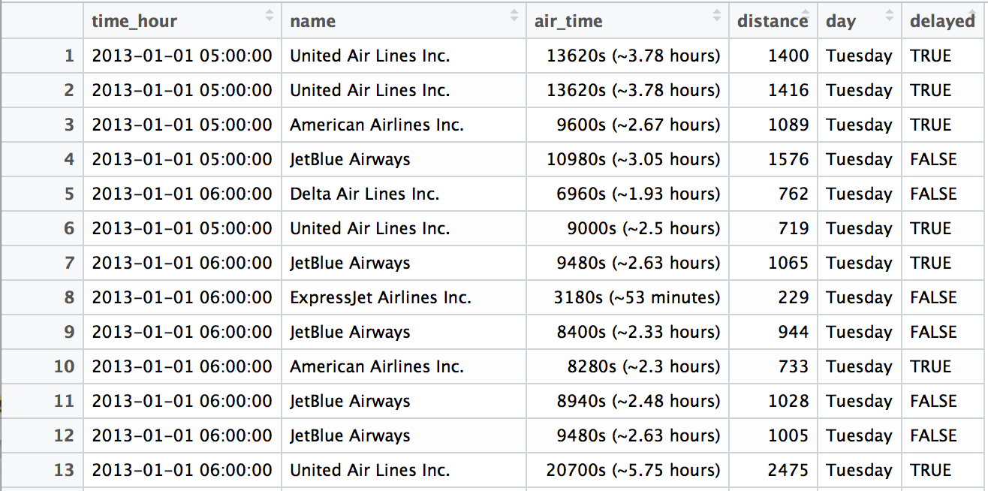
Quiz
What types of data are in this data set?

Slide 17
Quiz
What types of data is this?
"2013-01-01 05:00:00"

Slide 18
Outline
Introduction and Joining Data | 8:00 - 9:45
Morning Break | 9:45 - 10:15
Data Types | 10:15 - 12:00
Lunch | 12:00 - 1:30
Model Data | 1:30 - 3:15
Afternoon Break | 3:15 - 3:45
Reproducible Reporting | 3:45 - 5:30

Slide 19
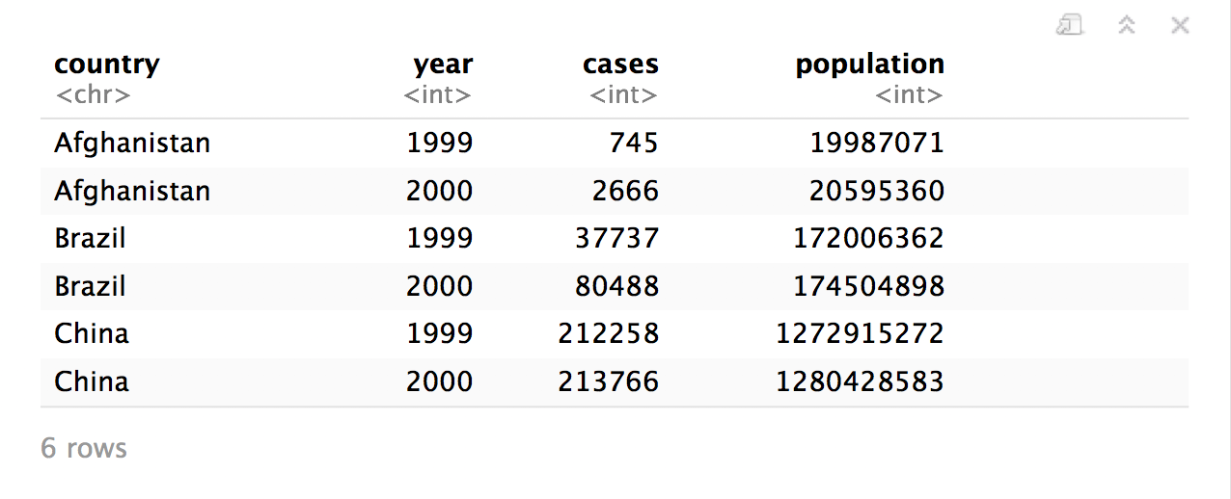
Quiz
What are the variables in this data set?
table1

Slide 20
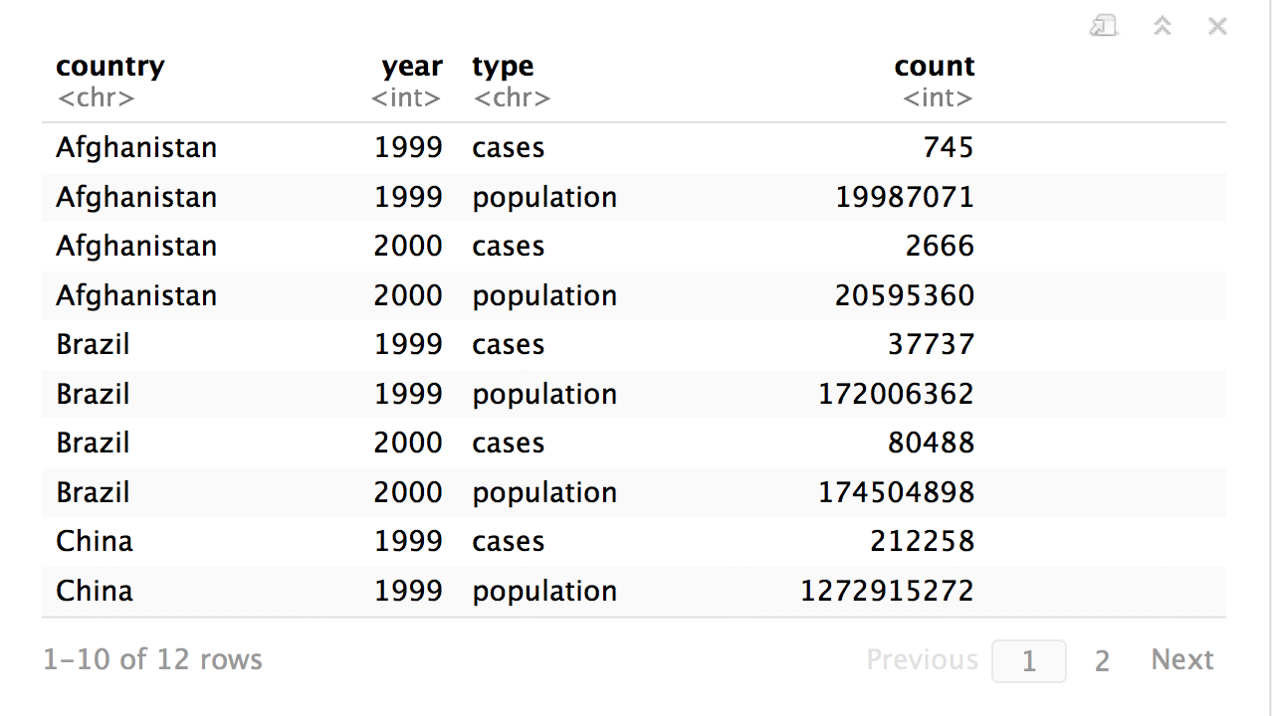
Quiz
What are the variables in this data set?
table2

Slide 21
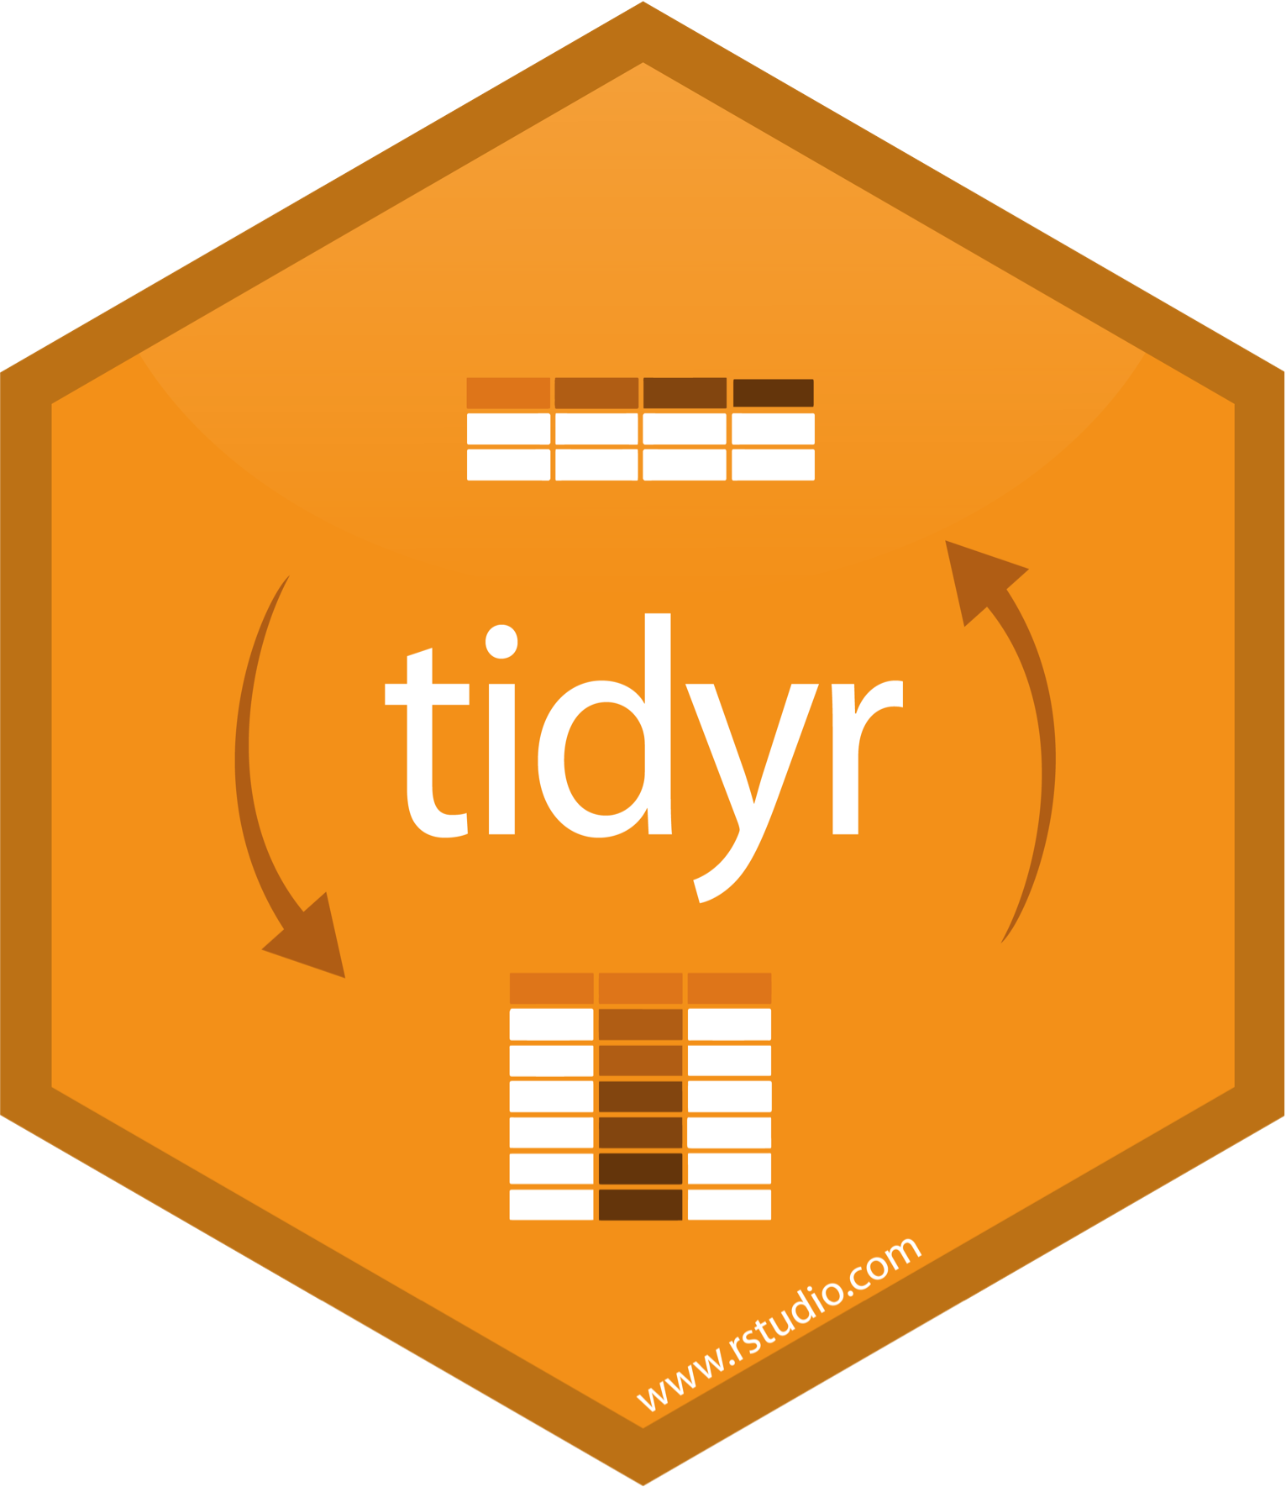
table1$country
table1$year
table1$cases
table1$population

Slide 22
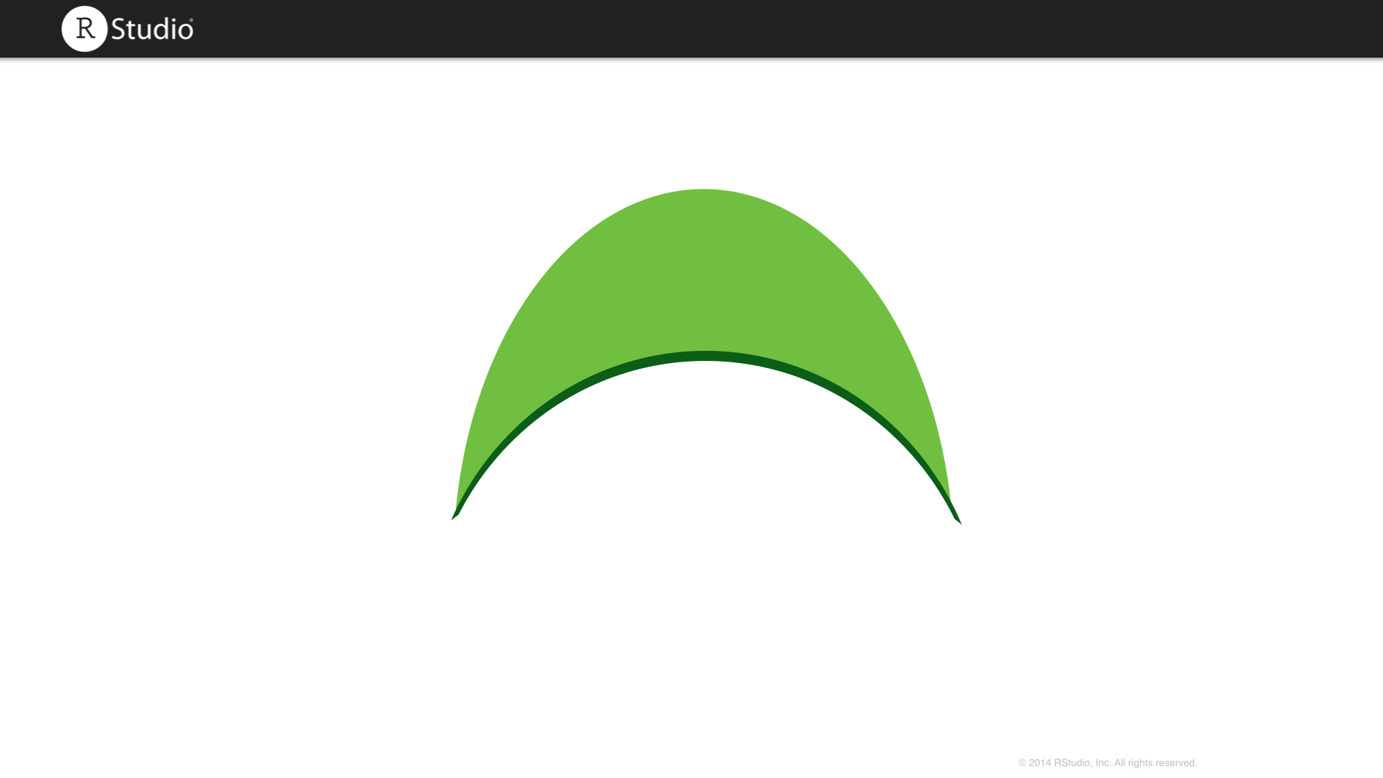
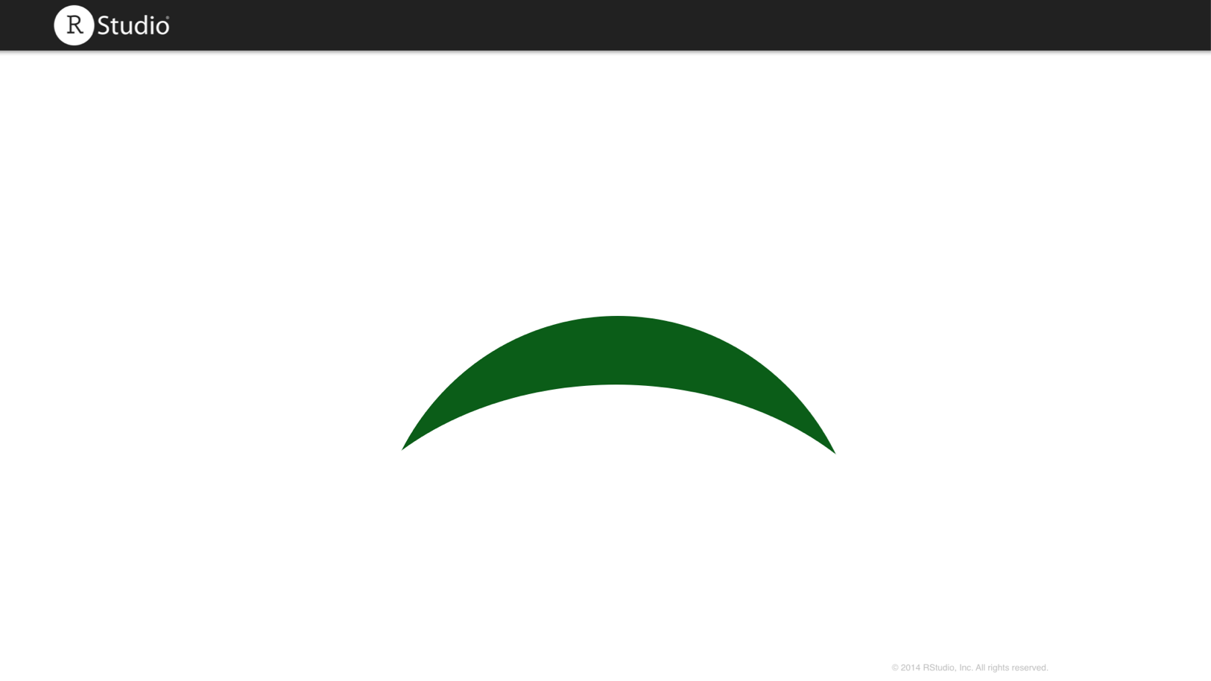
table2$country
table2$year
table2$count[c(1,3,5,7,9,11)]
table2$count[c(2,4,6,8,10,12)]

Slide 23
"Better experimental design = simpler statistics.
Better data model = simpler analysis."
- Jenny Bryan

Slide 24
Outline
Introduction and Joining Data | 8:30 - 10:15
Morning Break | 10:15 - 10:30
Data Types | 10:30 - 12:3
Lunch | 12:30 - 2:00
Tidy Data | 2:00 - 3:15
Afternoon Break | 3:15 - 3:30
Lists | 3:30 - 5:00

Slide 25
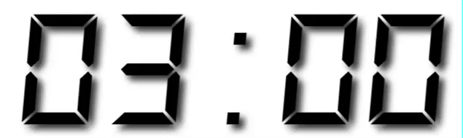
Your Turn
Go here and log in for the class materials
https://rstudio.cloud/project/385988
Navigate up to the 02-Join folder.
Open 02-Join-Exercises.Rmd

Slide 26
Your Turn 0
Navigate up to the 02-Join folder.
Open 02-Join-Exercises.Rmd

